Slide 1
Recursion
Presentation for use with the textbook Data Structures and Algorithms in Java, 6th edition, by M. T. Goodrich, R. Tamassia, and M. H. Goldwasser, Wiley, 2014

Slide 2
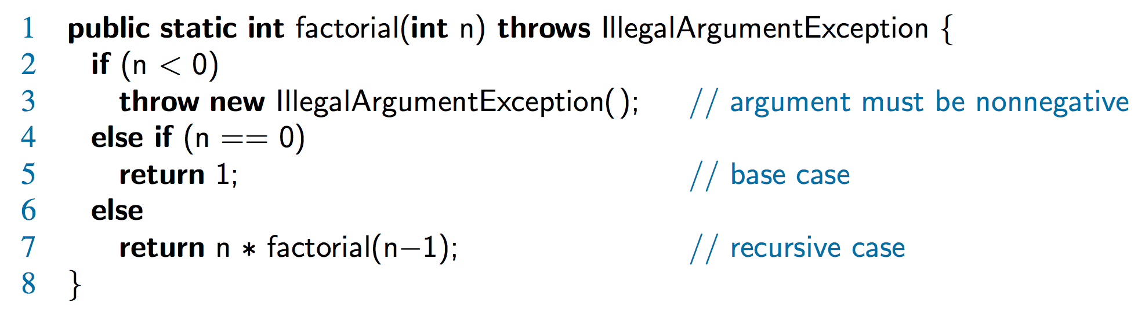
The Recursion Pattern
Recursion: when a method calls itself
Classic example – the factorial function:
n! = 1· 2· 3· ··· · (n-1)· n
Recursive definition:
As a Java method:

Slide 3
Content of a Recursive Method
Base case(s)
Values of the input variables for which we perform no recursive calls are called base cases (there should be at least one base case).
Every possible chain of recursive calls must eventually reach a base case. يجب أن تصل كل سلسلة ممكنة من الاستدعاءات الذاتيه في النهاية إلى الحالة الأساسية.
Recursive calls
Calls to the current method.
Each recursive call should be defined so that it makes progress towards a base case.

Slide 4
Visualizing Recursion
Recursion trace
A box for each recursive call
An arrow from each caller to callee
An arrow from each callee to caller showing return value
Example
return
4
*
call
6
=
24
final answer
recursiveFactorial
(
4
)
return
3
*
call
2
=
6
recursiveFactorial
(
3
)
return
2
*
call
1
=
2
recursiveFactorial
(
2
)
return
1
*
call
1
=
1
recursiveFactorial
(
1
)
return
call
1
recursiveFactorial
(
0
)

Slide 5
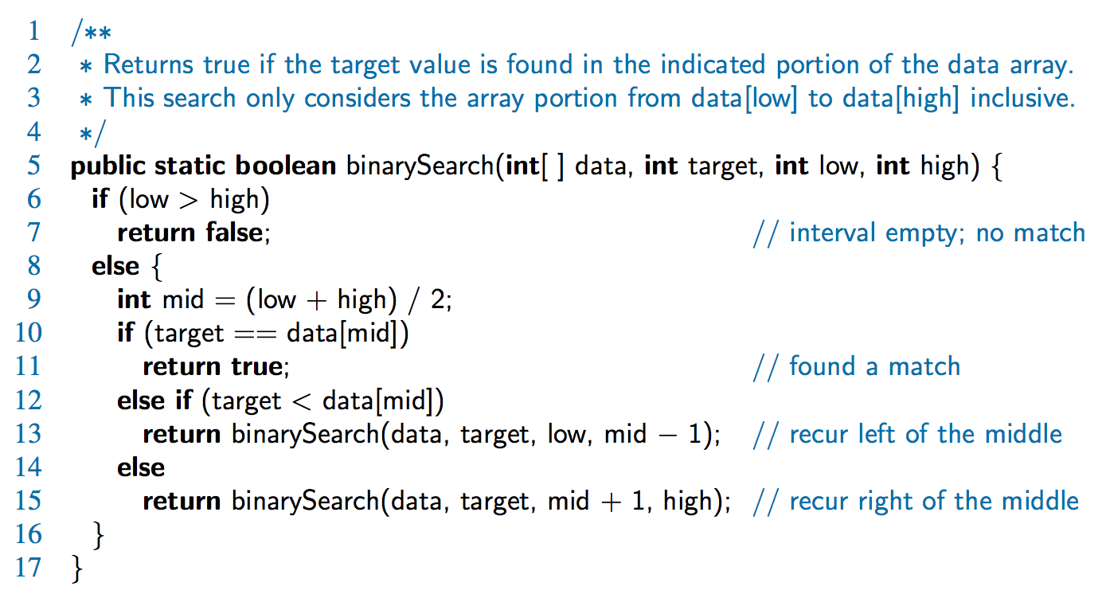
Binary Search
Search for an integer in an ordered list

Slide 6
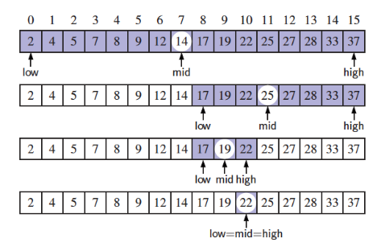
Visualizing Binary Search
We consider three cases:
If the target equals data[mid], then we have found the target.
If target < data[mid], then we recur(repeat) on the first half of the sequence.
If target > data[mid], then we recur on the second half of the sequence.

Slide 7
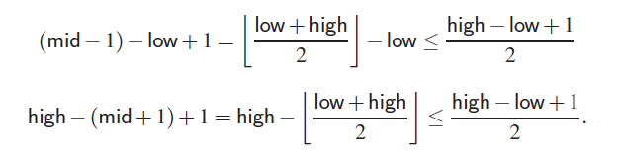
Analyzing Binary Search
Runs in O(log n) time.
The remaining portion of the list is of size high – low + 1
After one comparison, this becomes one of the following:
Thus, each recursive call divides the search region in half; hence, there can be at most log n levels

Slide 8
Binary Search Complexity Analysis: Why O(logn)?
Key Idea : At each step, binary search eliminates half of the remaining elements.
After 1st comparison: Search space reduces from n to n/2​.
After 2nd comparison: Search space reduces to n/4​.
After 3rd comparison: Search space reduces to n/8​, and so on.
Mathematical Representation :
The process continues until the search space is reduced to 1 element.
Number of steps required: Solve for k in ( 1= n/2^{k} ) ⟹2^{k}=n ⟹k=log2​(n)

Slide 9
Linear Recursion
A recursive method is called linear recursion if each invocation of the method makes at most one new recursive call .
It requires:
Clear base cases to terminate recursion.
A single recursive call in each step.
Progress towards the base case in every recursive call.

Slide 10
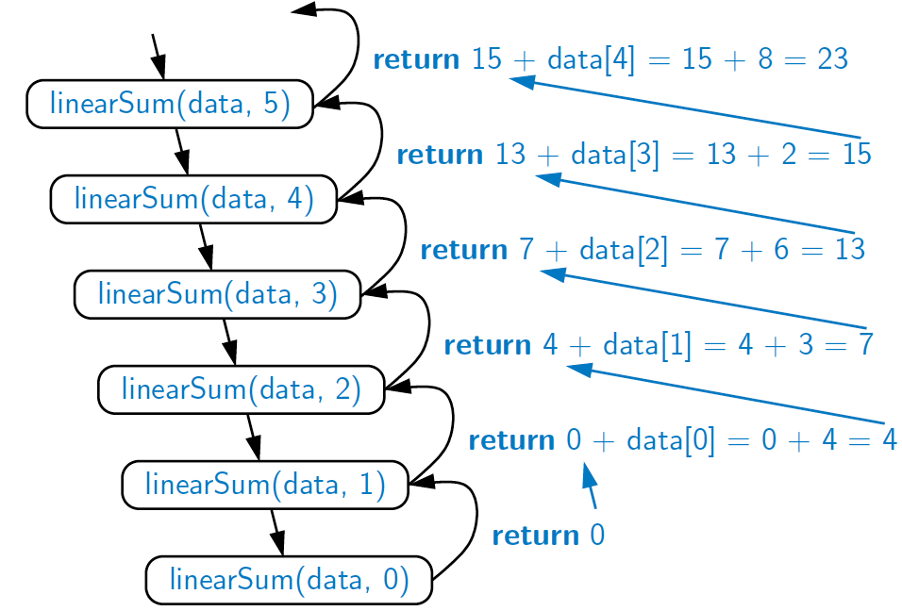
Example of Linear Recursion Computing the sum of a sequence recursively, by adding the last number to the sum of the first n−1.
Recursion trace of linearSum(data, 5) called on array data = [4, 3, 6, 2, 8]
Algorithm linearSum(A, n):
Input:
Array, A, of integers
Integer n such that
0 ≤ n ≤ |A|
Output:
Sum of the first n integers in A
if n = 0 then
return 0
else
return
linearSum(A, n - 1) + A[n - 1]

Slide 11
linearSum in java
/∗∗ Returns the sum of the first n integers of the given array. ∗/
public static int linearSum(int[ ] data, int n) {
if (n == 0)
return 0;
else
return linearSum(data, n−1) +data[n−1];
}

Slide 12
Reversing an Array
Algorithm reverseArray(A, i, j):
Input: An array A and nonnegative integer indices i and j
Output: The reversal of the elements in A starting at index i and ending at j
if i < j then
Swap A[i] and A[ j]
reverseArray(A, i + 1, j − 1)
return

Slide 13
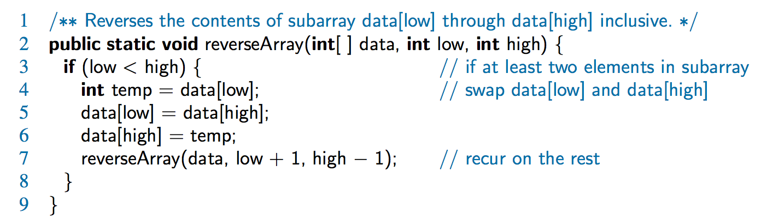
Defining Arguments for Recursion
In creating recursive methods, it is important to define the methods in ways that facilitate recursion.
This sometimes requires we define additional parameters that are passed to the method.
For example, we defined the array reversal method as reverseArray(A, i, j), not reverseArray(A)

Slide 14
Tail Recursion
Definition : Tail recursion is a specific type of linear recursion where the recursive call is the last operation performed in the method. This means that after making the recursive call, there are no further computations or operations to perform.
Key Points :
Tail recursion is always linear recursion : Since the recursive call must be the final step, it is impossible to make a second recursive call immediately afterward.
Immediate Return : After the recursive call, the result is returned directly without any additional processing.
Example : The array reversal method is an example of tail recursion.

Slide 15
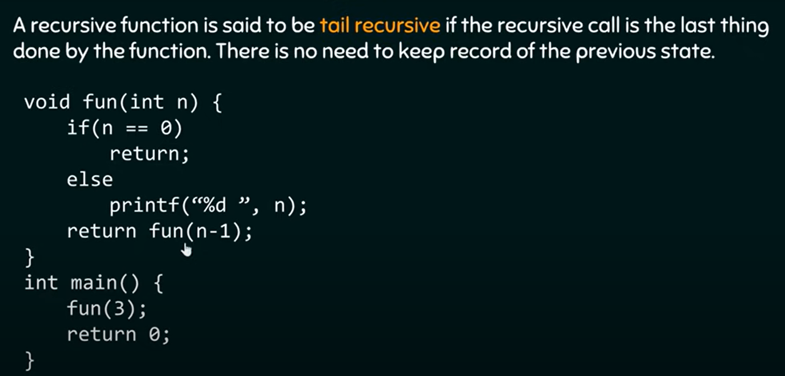

Slide 16
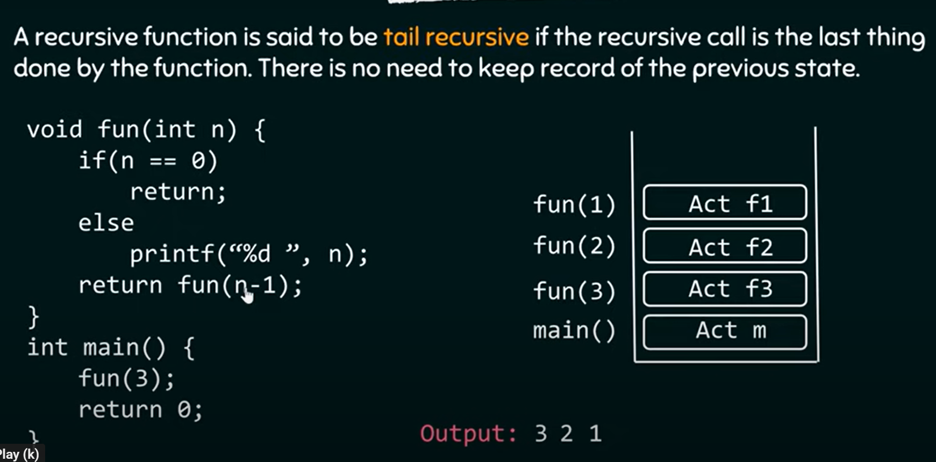

Slide 17
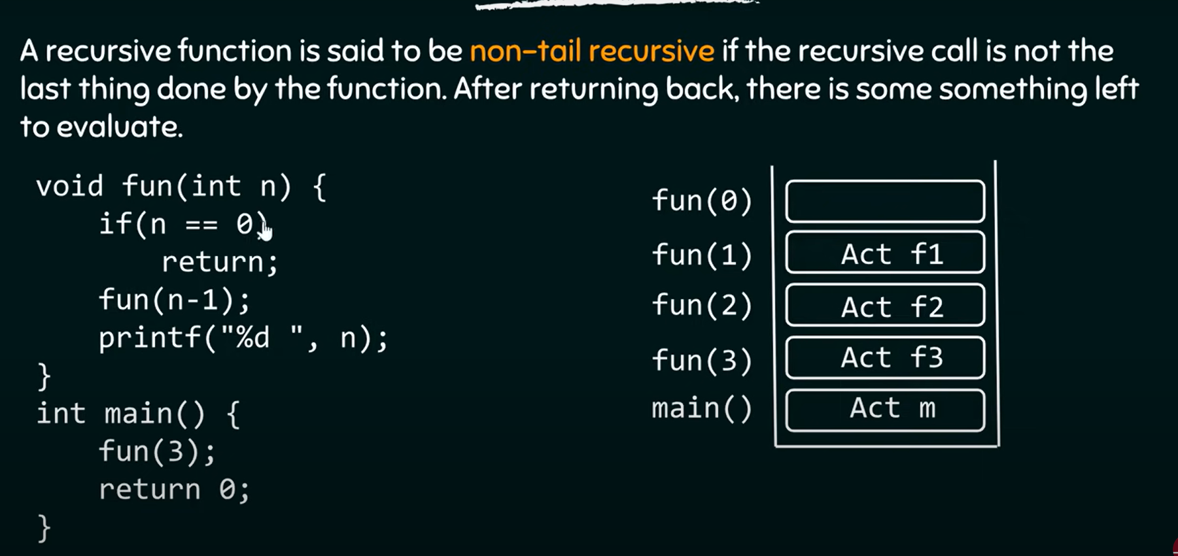

Slide 18
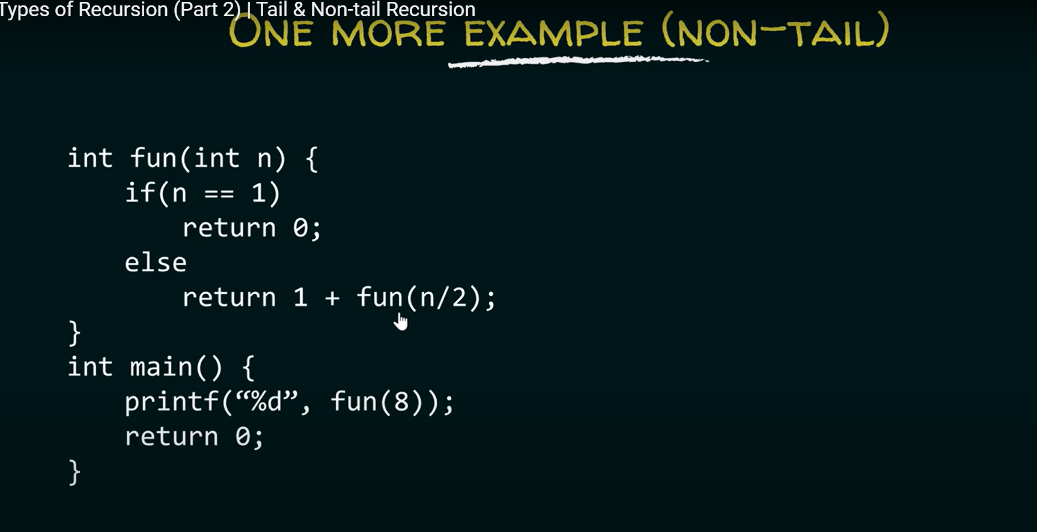

Slide 19
Example tail recursions
the binarySearch method
the reverseArray method

Slide 20
Example of non tail
factorial method,
This is not a tail recursion because an additional multiplication is performed after the recursive call is completed,
the linearSum method
power methods

Slide 21
Tail recursion
Such methods can be easily converted to non-recursive methods (which saves on some resources).
Example:
Algorithm IterativeReverseArray(A, i, j ):
Input: An array A and nonnegative integer indices i and j
Output: The reversal of the elements in A starting at index i and ending at j
while i < j do
Swap A[i ] and A[ j ]
i = i + 1
j = j - 1
return

Slide 22
lecture

Slide 23
Power x ^n :iterative way
int power(int x, int n){
int p=1;
for(int i=1; i<=n; i++)
p=x*p;
return p;
}
Theta (n)

Slide 24
Computing Powers
The power function,
p(x,n)=x^{n,} =x.x^{n-1}=x.p(x,n-1) can be defined recursively:
This leads to an power function that runs in O(n) time (for we make n recursive calls)
We can do better than this, however

Slide 25
Recursive Squaring
x^{n}= x^{n/2} * x^{n/2}
We can derive a more efficient linearly recursive algorithm by using repeated squaring:
For example,
2⁴ = 2^{(4/2)2} = (2^{4/2})² = (2²)² = 4² = 16
2⁵ = 2^{1+(4/2)2} = 2(2^{4/2})² = 2(2²)² = 2(4²) = 32
2⁶ = 2^{(6/ 2)2} = (2^{6/2})² = (2³)² = 8² = 64
2⁷ = 2^{1+(6/2)2} = 2(2^{6/2})² = 2(2³)² = 2(8²) = 128

Slide 26
Recursive Squaring Method
Algorithm Power(x, n):
Input: A number x and integer n = 0
Output: The value x^{n}
if n = 0 then
return 1
if n is odd then
y = Power(x, (n - 1)/ 2)
return x · y ·y
else
y = Power(x, n/ 2)
return y · y

Slide 27
Analysis
Algorithm Power(x, n):
Input: A number x and integer n = 0
Output: The value x^{n}
if n = 0 then
return 1
if n is odd then
y = Power(x, (n - 1)/ 2)
return x · y · y
else
y = Power(x, n/ 2)
return y · y
Each time we make a recursive call we halve the value of n; hence, we make log n recursive calls. That is, this method runs in O(log n) time.
It is important that we use a variable twice here rather than calling the method twice.

Slide 28
Power with theta(n)
public static int power(int X, int n) {
if (n != 0) {
// recursive call to power()
return (X * power(X, n - 1));
}
else {
return 1;
}
}
T(n)=1+T(n-1)=n

Slide 29
Recursive power with java (log n)
public static int power(int X, int n)
{ int y;
if(n==0)
return 1;
else
if (n%2==1){// odd
y=power( X,(n-1)/2);
return X * y *y;
}
else {// even
y=power( X, n/2);
return y *y;
}
}
T(n)=1+T(n/2)=log n
Algorithm Power(x, n):
Input: A number x and integer n = 0
Output: The value x^{n}
if n = 0 then
return 1
if n is odd then
y = Power(x, (n - 1)/ 2)
return x · y ·y
else
y = Power(x, n/ 2)
return y · y

Slide 30
Another Binary Recusive Method
Problem: add all the numbers in an integer array A:
Algorithm BinarySum(A, i, n):
Input: An array A and integers i and n
Output: The sum of the n integers in A starting at index i
if n = 1 then // n=n-1
return A[i]
return BinarySum(A, i, n/ 2) + BinarySum(A, i + n/ 2, n)
Example trace:
0
,
8
0
,
4
4
,
8
0
,
2
2
4
4
,
6
6
,
8
0
,
1
1
,
2
2
,
3
3
,
4
4
,
5
5
,
6
6
,
7
7
,
8

Slide 31
Computing Fibonacci Numbers
Fibonacci numbers are defined recursively:
F₀ = 0
F₁ = 1
F_{i} = F_{i-1} ⁺ F_{i-2} for i > 1.
0 1 1 2 3 5 8 13 21 33 ….
Recursive algorithm (first attempt):
Algorithm BinaryFib(k):
Input: Nonnegative integer k
Output: The kth Fibonacci number F_{k}
if k = 1 then
return k
else
return BinaryFib(k − 1) + BinaryFib(k − 2)

Slide 32
Analysis
Let n_{k} be the number of recursive calls by BinaryFib(k)
n₀ = 1
n₁ = 1
n₂ = n₁ + n₀ + 1 = 1 + 1 + 1 = 3
n₃ = n₂ + n₁ + 1 = 3 + 1 + 1 = 5
n₄ = n₃ + n₂ + 1 = 5 + 3 + 1 = 9
n₅ = n₄ + n₃ + 1 = 9 + 5 + 1 = 15
n₆ = n₅ + n₄ + 1 = 15 + 9 + 1 = 25
n₇ = n₆ + n₅ + 1 = 25 + 15 + 1 = 41
n₈ = n₇ + n₆ + 1 = 41 + 25 + 1 = 67.
Note that n_{k} at least doubles every other time
That is, n_{k} > 2^{k/2}. It is exponential!

Slide 33
A Better Fibonacci Algorithm
public static int fibo_L(int n)
{
int t1 = 0, t2 = 1;
System.out.println("Fibonacci Series of " + n + " terms:");
for (int i = 1; i <= n; ++i) {
System.out.print(t1 + ", ");
// compute the next term
int sum = t1 + t2;
t1 = t2;
t2 = sum;
}
return t2;
}
T(n)= n

Slide 34
End

